Slide 1
Crop Science
Lecture 3
01st September 2021
TLANSLOCATION

Slide 2
Translocation
Sap in the phloem is not translocated exclusively in either an upward or a downward direction
translocated from areas of supply, called sources, to areas of metabolism or storage, called sinks
Sap Sources include:
Supply organs, mature leaves, storage organ
Sinks include:
any non photosynthetic organs of the plant, organs not produce enough photosynthetic products, tubers, developing fruits, and immature leaves, which must import carbohydrate for normal development,

Slide 3
Sap distribution
Factors affecting distribution
Proximity:
The upper mature leaves on a plant usually provide photosynthates to the growing shoot tip and young, immature leaves; the lower leaves supply predominantly the root system. Intermediate leaves export in both directions, bypassing the intervening mature leaves.
Development
Whereas the root and shoot apices are usually the major sinks during vegetative growth, fruits generally become the dominant sinks during reproductive development, particularly for adjacent and other nearby leaves
Vascular connections
Source leaves supply sinks with which they have direct vascular connections. In the shoot system a leaf is connected via the vascular system to other leaves directly above or below it on the stem

Slide 4
Materials translocation
Materials translocated in the phloem include:
sucrose, amino acids, hormones, and some inorganic ions
Water is the most abundant substance transported in the phloem
Dissolved solutes are translocated through water such as carbohydrates and Sucrose
Phloem and Xylem Interact to Transport Nitrogenous Compounds
Nitrogen is transported throughout the plant in either inorganic or organic form, in the phloem almost entirely in organic form, in the xylem it can be transported either as nitrate or as part of an organic molecule

Slide 5
Respiration
Aerobic respiration is the biological process by which reduced organic compounds are mobilized and subsequently oxidized
During respiration, free energy is released and stored in a compound, ATP, which can be readily utilized for the maintenance and development of the plant
From a chemical standpoint, plant respiration can be expressed as:
C₁₂H₂₂O₁₁ + 12 O₂ → 12 CO₂ + 11 H₂O

Slide 6
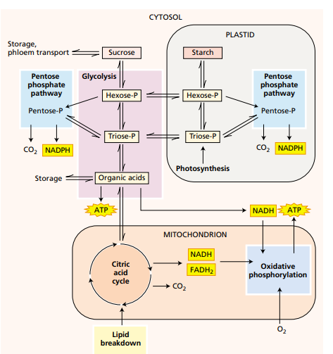
Respiration overview

Slide 7
Respiration overview
Glycolysis Converts Carbohydrates into Pyruvate, Producing NADH and ATP Glycolysis occurs in all living organisms
Pentose phosphate pathway, also located both in the cytosol and the plastid, the six-carbon glucose6-phosphate is initially oxidized to the five-carbon ribulose-5-phosphate
The carbon is lost as CO2, and reducing power is conserved in the form of two molecules of another reduced pyridine nucleotide, NADPH
Citric acid cycle, pyruvate is oxidized completely to CO₂ and a considerable amount of reducing power is generated in the process

Slide 8
Environmental factors affecting respiration
Factors controlling respiration:
environmental oxygen
temperature,
carbon dioxide

Slide 9
Lipid metabolism
Animals use fats for energy storage, plants use them mainly for carbon storage
Fats and oils are important storage forms of reduced carbon in many seeds, including those of agriculturally important species such as soybean, sunflower, peanut, and cotton
Oils often serve a major storage function in non domesticated plants that produce small seeds and Some fruits, such as olives and avocados, also store fats and oils

Slide 10
Storage lipids
Lipids are Converted into Carbohydrates in Germinating Seeds After germinating, oil-containing seeds metabolize stored triacylglycerols by converting lipids to sucrose
Plants are not able to transport fats from the endosperm to the root and shoot tissues of the germinating seedling, so they convert stored lipids to mobile form of carbon, such as sucrose
The conversion of lipids to sucrose in oilseeds is triggered by germination and begins with the hydrolysis of fats stored in the oil bodies to free fatty acids,
The initial step in the conversion of lipids to carbohydrate is the breakdown of fats stored in the oil bodies by the enzyme lipase

Slide 11
Nutrient assimilation
Higher plants are autotrophic organisms that can synthesize their organic molecular components out of inorganic nutrients obtained from their surroundings
Assimilation of some nutrients, particularly nitrogen, requires a complex series of biochemical reactions that are among the most energy-requiring reactions in living organisms such as:
Nitrate (NO3 –) assimilation, the nitrogen in NO3 – is converted to a higher-energy form in nitrite (NO2 –), then to a yet higher-energy form in ammonium (NH4 +)
Plants such as legumes form symbiotic relationships with nitrogen-fixing bacteria to convert molecular nitrogen (N2) into ammonia (NH3

Slide 12
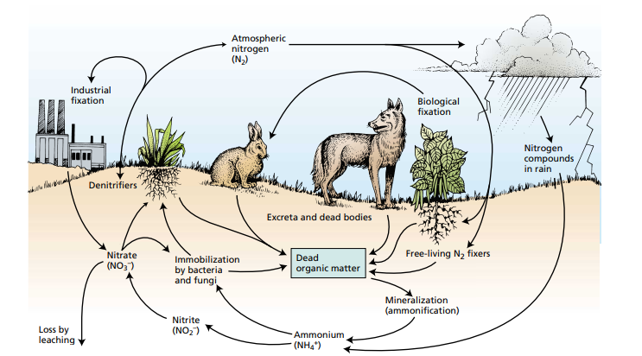
Nitrogen cycle

Slide 13
Metabolites
In nature, plants are surrounded by potential enemies such as bacteria, viruses, fungi, nematodes, mites, insects, mammals, and other herbivorous animals
Plants produce organic compounds that appear to have no direct function in growth and development. These substances are known as secondary metabolites
They protect plants against being eaten by herbivores (herbivory) and against being infected by microbial pathogens.
They serve as attractants for pollinators and seed dispersing animals and as agents of plant–plant competition
Plant secondary metabolites can be divided into three chemically distinct groups:
terpenes, phenolics, and nitrogen-containing compounds.

Slide 14
Secondary metabolites
In Plants Terpenes are toxins and feeding deterrents to many plant feeding insects and mammals playing important defensive roles in the plants
Phenolics limit the growth of other plants From leaves, and roots
Investigation of the effects of these compounds on neighbouring plants is the study of allelopathy
Tannins are general toxins that significantly reduce the growth and survivorship of many herbivores
nitrogen-containing compounds
alkaloids function as defence against predators, especially mammals, because of their general toxicity and deterrence capability.

Slide 15
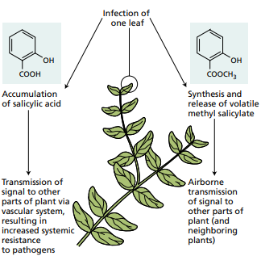
Plant defence
Antimicrobial Compounds Are Synthesized before Pathogen Attack
Plant defence are induced by herbivore attack or microbial infection
When a plant survives the infection of a pathogen at one site, it often develops increased resistance to subsequent attacks

